Slide 1



Minikube
Local testing

Slide 2
What is it?
minikube is local Kubernetes, focusing on making it easy to learn and develop for Kubernetes.
Notes:
Allows you to test K8S code in a docker environment. No need to have multiple IDEs open to test code. Use K8S features such as creating a load balancer, filemount systems, secrets, configmaps. Use different containers runtimes such as Hyper-V, docker, Virtualbox, etc

Slide 3
Pre-reqs
Need WSL Installed and configured. Include Docker installs
https://dev.michelin.com/search/wsl
Need a linux package manger installed
Apt
YUM
Dpkg (Debian)
Need Kubectl
Container manager like Docker on Linux.

Slide 4
Install minikube
https://minikube.sigs.k8s.io/docs/start/
https://minikube.sigs.k8s.io/docs/handbook/untrusted_certs/ - copy Michelin certificates to $HOME/.minikube/certs to allow minikube dashboard to work
Notes:
First time starting minikube it takes about 10 minutes to download minikube images to your environment. Otherwise it is less than 2 minutes to start. It stays running until you reboot your machine or it crashes.

Slide 5
Commands to Keep
minikube start
kubectl config use-context minikube # Switch to minikube context
docker login docker.artifactory.michelin.com
docker image build . -t <imagename> #build docker image
docker image ls #List images built with docker
minikube image load <imagename> # Load docker built images into minikube
minikube image ls # List images in minikube
kubectl create deployment <name> --image=<imagename>:<version> # use to create a deployment file
kubectl apply -f deploy.yml #applies deployment file in k8s
kubectl logs deployment.apps/<deployname> #gets logs
minikube dashboard --url #show Minikube dashboard application
kubectl port-forward svc/<servicename> port:port #creates a tunnel from k8s to local machine
Notes:
For all these commands you can create your own command aliases in Linux to shorten the typing of the entire command.

Slide 6
Demo
Deployed backend application in minikube
Debugging frontend application locally
Notes:
https://minikube.sigs.k8s.io/docs/handbook/accessing/

Slide 7
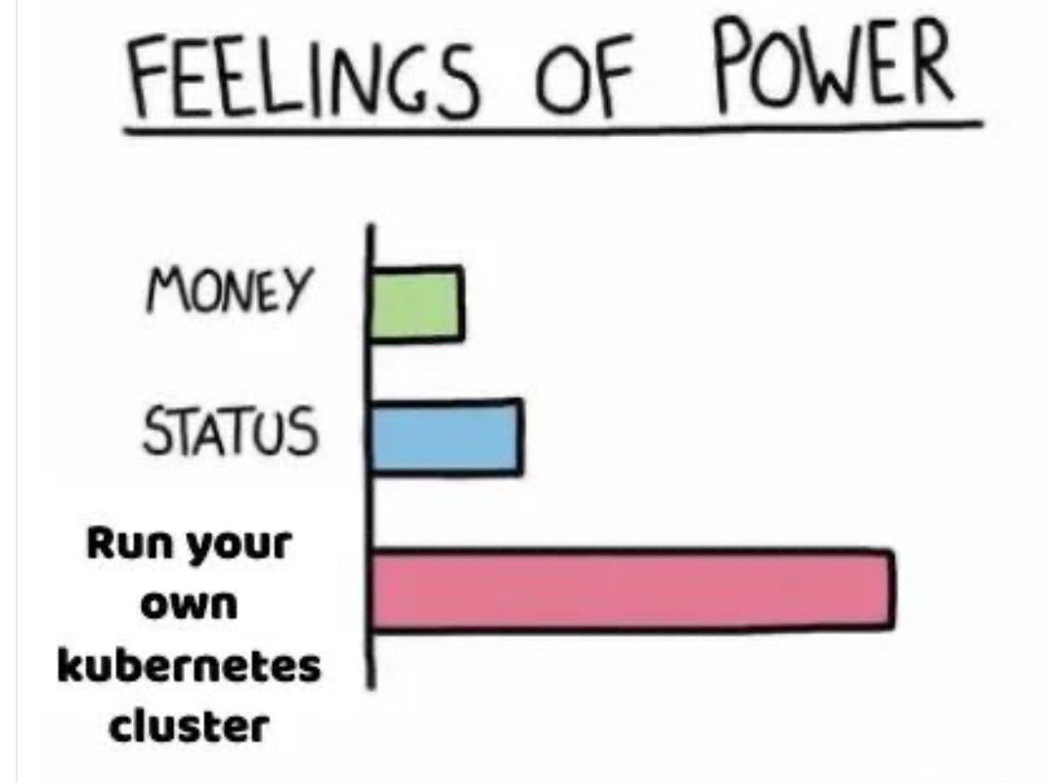
Questions

